Slide 1
RNAseq analysis in Netrin-1 time course stimulation in DIV2 Rat Cortical Neurons
Notes:
TIMING ~1.5 min.
Good morning, and thank you for being here. My thesis asks a simple but under-explored question: when a neuron meets Netrin-1 — the classic axon-guidance cue — what happens to its transcriptome in the first MINUTES? Using a 5- and 15-minute bulk RNA-seq time course in E18 rat cortical neurons, I show that Netrin-1 triggers a rapid, coordinated and almost perfectly REVERSIBLE transcriptional program. Let me walk you through it.

Slide 2
ROADMAP
Outline
▸ Background — Netrin-1 and the gap in acute transcription
– Why look at minutes, not hours?
▸ Question, hypothesis & experimental design
▸ Analysis pipeline & quality control
▸ Results
– 1 · The 5-minute response (genes)
– 2 · Transient dynamics (IEGs, ROCK1)
– 3 · Pathway-level coordination (GSEA)
– 4 · Return to baseline — the r = −0.99 mirror
▸ Discussion, limitations & conclusions
THE ONE-SENTENCE STORY
A 5-min Netrin-1 pulse activates an axon-guidance / projection program and suppresses RNA-processing & ribosome biogenesis — then by 15 min returns to baseline with r = −0.99 precision.
2
Notes:
TIMING ~1 min. Here is the roadmap. I'll spend the first third on context and methods, the middle on four blocks of results, and close with discussion and limitations. If you remember one thing, remember the box on the right: a transient program that is switched on and then precisely switched off within 15 minutes.

Slide 3
BACKGROUND
Netrin-1: a classic guidance cue — acting in seconds
▸ Netrin-1 is a prototypical axon-guidance molecule.
– Steers the growth cone via the DCC and UNC5 receptors.
▸ Its canonical mechanism is POST-translational and LOCAL.
– Cytoskeletal remodeling, local protein translation.
– Operates on a seconds-to-minutes timescale.
▸ So the field has focused on protein-level signaling…
– …and largely overlooked the nucleus on this timescale.
CANONICAL NETRIN-1 SIGNALING
Netrin-1
↓
DCC / UNC5 receptors
↓
Cytoskeleton · ROCK · local translation
↓
Growth-cone turning (seconds–minutes)
3
Notes:
TIMING ~1.5 min. Start with what we know. Netrin-1 is THE textbook guidance cue. It binds DCC and UNC5 and steers the growth cone. Crucially, its classic mechanism is post-translational and local — cytoskeletal remodeling and local translation, on a seconds-to-minutes scale. Because the action is at the protein level and right at the growth cone, the field has paid little attention to what the NUCLEUS is doing on this same fast timescale. That is the door this thesis walks through.

Slide 4
BACKGROUND
The knowledge gap: minutes-scale transcription
0
5 min
15 min
1 h
hours–days
THIS STUDY
Where most transcriptomic studies look
▸ Almost all Netrin transcriptome studies sample HOURS to DAYS after stimulation.
▸ The acute, minute-scale transcriptional response is essentially uncharted.
▸ Open questions: Does the transcriptome change within minutes? How? And is the change transient or sustained?
4
Notes:
TIMING ~1.5 min. Here's the gap, on a timeline. Almost every transcriptomic study of Netrin samples HOURS to DAYS out — the right-hand side. The minute-scale window — 5 and 15 minutes — is essentially blank. So three open questions: Does the transcriptome change at all within minutes? If so, how — which programs? And critically, is that change transient, or does it lock in a sustained reprogramming? Those questions define the thesis.

Slide 5
AIM
Research question & hypothesis
Research question
Does acute Netrin-1 stimulation rapidly reshape the neuronal transcriptome — and is that response transient or persistent?
HYPOTHESIS
APPROACH
▸ Netrin-1 induces a fast, coordinated transcriptional response…
▸ …that is transient — switched on, then switched off — rather than a stable reprogramming.
▸ Bulk RNA-seq time course: 0 / 5 / 15 min.
▸ Gene-level differential expression (DESeq2).
▸ Pathway-level coordination via GSEA.
▸ Compare 5-vs-0 against 15-vs-5 to test reversibility.
5
Notes:
TIMING ~1.5 min. Stated plainly: does acute Netrin-1 rapidly reshape the transcriptome, and is the response transient or persistent? My hypothesis — fast, coordinated, and TRANSIENT. The approach, on the right: a 0/5/15-minute bulk RNA-seq time course, gene-level DE with DESeq2, and pathway-level GSEA. The key test of reversibility is comparing the 5-vs-0 contrast against the 15-vs-5 contrast — if the program reverses, those two should be mirror images. Hold that thought; it pays off at the end.

Slide 6
METHODS
Experimental design
▸ E18 rat cortical mixed primary cultures.
▸ Three conditions:
– Vehicle (PBS, 5 min) — the reference / 0 min
– Netrin-1, 5 min
– Netrin-1, 15 min
▸ 3 biological replicates → 9 samples total.
▸ Design limitation (stated up front):
– One shared PBS-5min control serves BOTH Netrin timepoints — there is no independent PBS-15min control.
– → confounds the 15-vs-0 contrast; main results use 5v0 and 15v5.
9 SAMPLES = 3 CONDITIONS × 3 REPLICATES
Vehicle / 0 min
rep 1
rep 2
rep 3
Netrin-1 5 min
rep 1
rep 2
rep 3
Netrin-1 15 min
rep 1
rep 2
rep 3
6
Notes:
TIMING ~1.5 min. The design: E18 rat cortical primary cultures, three conditions — vehicle, 5-minute Netrin, 15-minute Netrin — three biological replicates, nine samples. I want to flag a limitation immediately, because it shapes how I read the data: there is ONE shared PBS control, taken at 5 minutes, serving both Netrin timepoints. There is no independent 15-minute vehicle. That confounds the 15-vs-0 comparison with elapsed time, so my main results lean on the two clean contrasts: 5-vs-0 and 15-vs-5. I'll be explicit whenever this matters.

Slide 7
METHODS
Analysis pipeline
DRAGEN Salmon
tximport → DESeq2
Differential expr.
GSEA
Integration
gene-level quant
(quant.genes.sf)
→
length-offset import
32,623 → 14,161 genes
→
~ replicate + timepoint
Wald: 5v0 · 15v0 · 15v5 + LRT
→
gseGO(BP) + gseKEGG
ranked by Wald stat
→
transient-dynamics model
5v0 vs 15v5 mirror
Quantification with DRAGEN Salmon at gene level; counts imported via tximport with a length offset into DESeq2. Two-pass filtering keeps 14,161 of 32,623 genes (85.6% mapped to SYMBOL via org.Rn.eg.db). DE model includes replicate as a batch term. Batch correction (limma) is used for visualization only — the DE tests use raw counts.
7
Notes:
TIMING ~1.5 min. The pipeline in five steps. Quantification with DRAGEN Salmon at gene level; import into DESeq2 through tximport with a length offset. Two-pass filtering takes us from ~32,600 to ~14,200 genes, about 86% of which map to a gene symbol. Differential expression, GSEA, and finally an integration step where I directly compare the 5-vs-0 and 15-vs-5 contrasts. One technical but important point: I correct for batch ONLY for visualization. The statistical tests always run on raw counts with the batch term in the model — I never test on adjusted data.

Slide 8
METHODS
Statistical model & significance
DIFFERENTIAL EXPRESSION
GENE-SET ENRICHMENT (GSEA)
▸ Model: ~ replicate + timepoint (ref = Vehicle).
▸ Replicate is the dominant variance source:
– PCA: replicate ≈ 52%, timepoint ≈ 34%.
▸ Wald contrasts: 5v0, 15v0, 15v5.
▸ LRT (reduced ~ replicate) for time-varying genes.
▸ Significance tiers:
– RELAXED: padj < 0.05
– STRICT: padj < 0.05 & |log2FC| > 0.585 (FC > 1.5)
▸ clusterProfiler: gseGO(BP) + gseKEGG (rno).
▸ Ranking statistic: DESeq2 Wald stat (descending).
▸ Entrez de-duplicated, keeping max |stat|.
▸ minGSSize 15 · maxGSSize 500 · BH · seed 123.
▸ GO simplified (cutoff 0.7) to remove redundancy.
▸ Why GSEA matters here:
– Acute signal is weak at single-gene level — pathway aggregation reveals the coordinated program.
8
Notes:
TIMING ~1.5 min. Two methodological pillars. On the left, differential expression: the model is replicate plus timepoint. Replicate genuinely dominates — about 52% of variance versus 34% for timepoint — so treating it as a batch term is essential. I report two significance tiers, a relaxed FDR-only cut and a strict cut that also requires a 1.5-fold change. On the right, GSEA, ranked by the Wald statistic. The key conceptual point is at the bottom: the acute signal is weak gene-by-gene, so GSEA — which aggregates across whole pathways — is where the biology becomes visible. That's why my main analysis is at the pathway level.

Slide 9
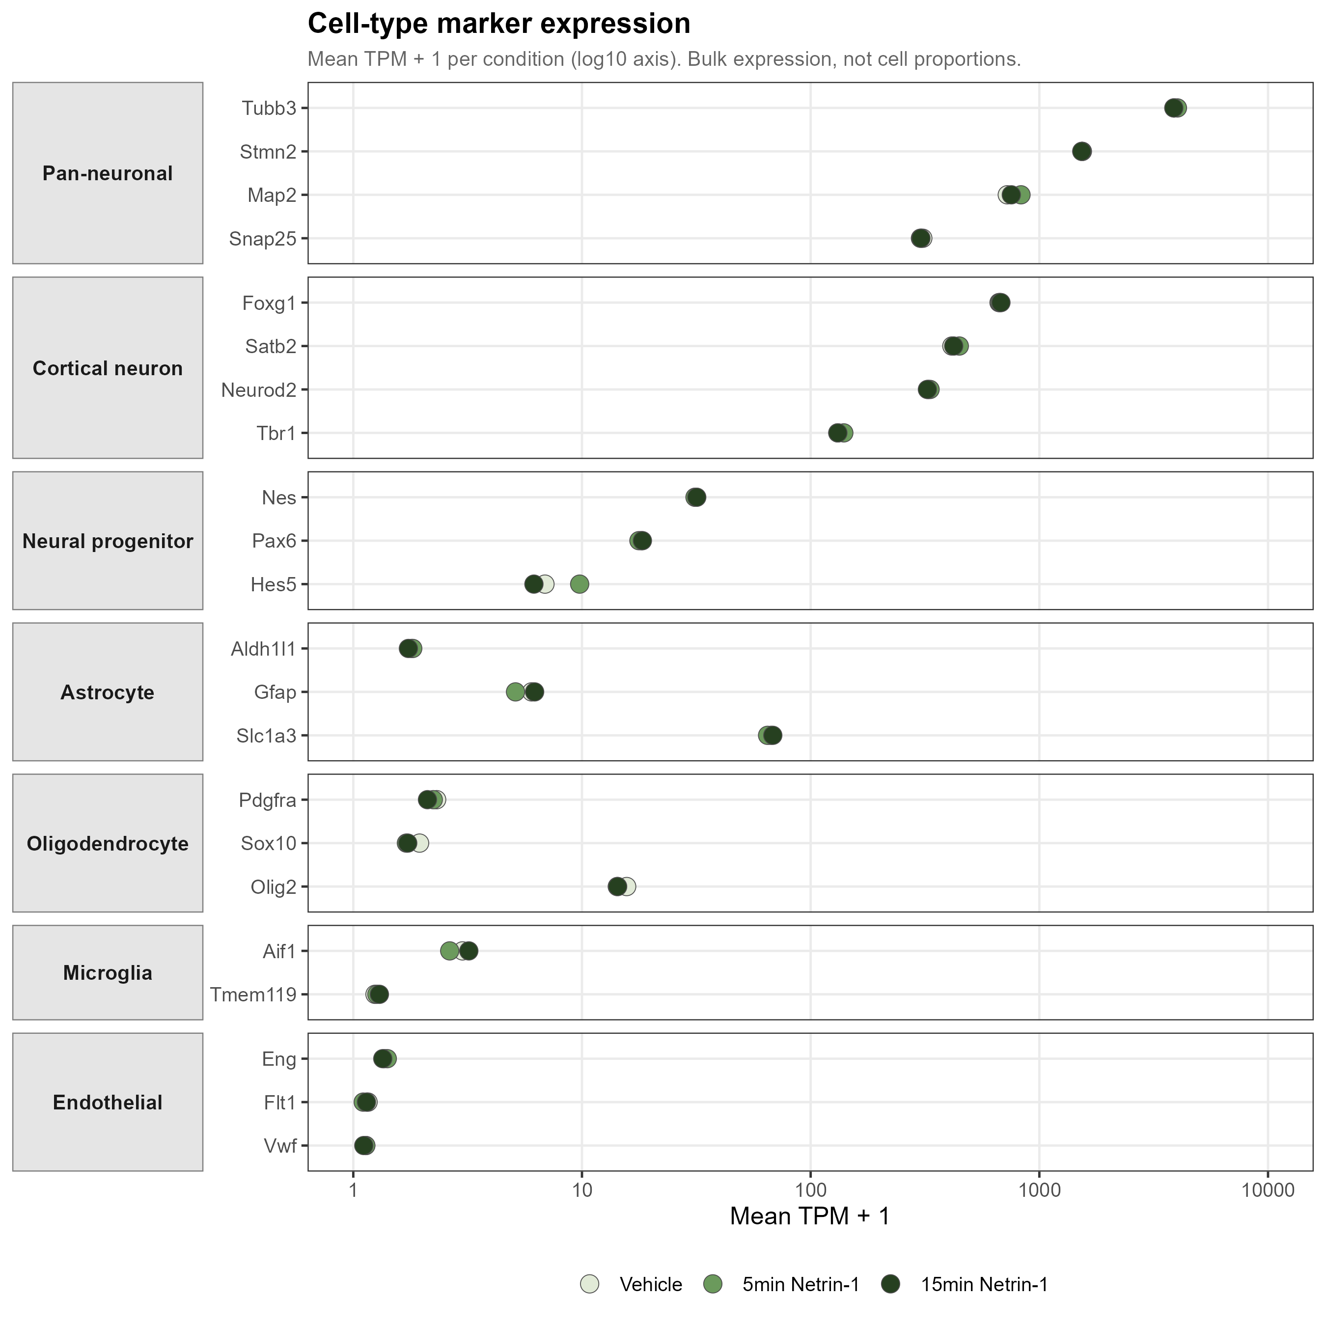
RESULTS · QC
Quality control I — cultures are neuron-dominated & stable
▸ Pan-neuronal markers dominate:
– Tubb3 ≈ 3900 TPM, Stmn2 ≈ 1540, Map2 ≈ 750.
– 2–4 orders of magnitude above glial / endothelial markers (Vwf, Flt1 ≈ 0.1 TPM).
▸ Marker expression is near-identical across all three conditions.
– → Cell composition does NOT change.
▸ Therefore downstream changes reflect a genuine transcriptional response, not a shift in cell types.
9
Notes:
TIMING ~1.5 min. First QC question: what are we even sequencing, and is it stable? Pan-neuronal markers — Tubb3, Stmn2, Map2 — sit at hundreds to thousands of TPM, two to four orders of magnitude above glial and endothelial markers. So these are neuron-dominated cultures. Just as important: the marker profile is essentially identical across vehicle, 5-minute, and 15-minute conditions. Five or fifteen minutes is far too short to change cell composition — and the data confirm it. That lets me attribute everything downstream to a real transcriptional response, not to cells appearing or disappearing.

Slide 10
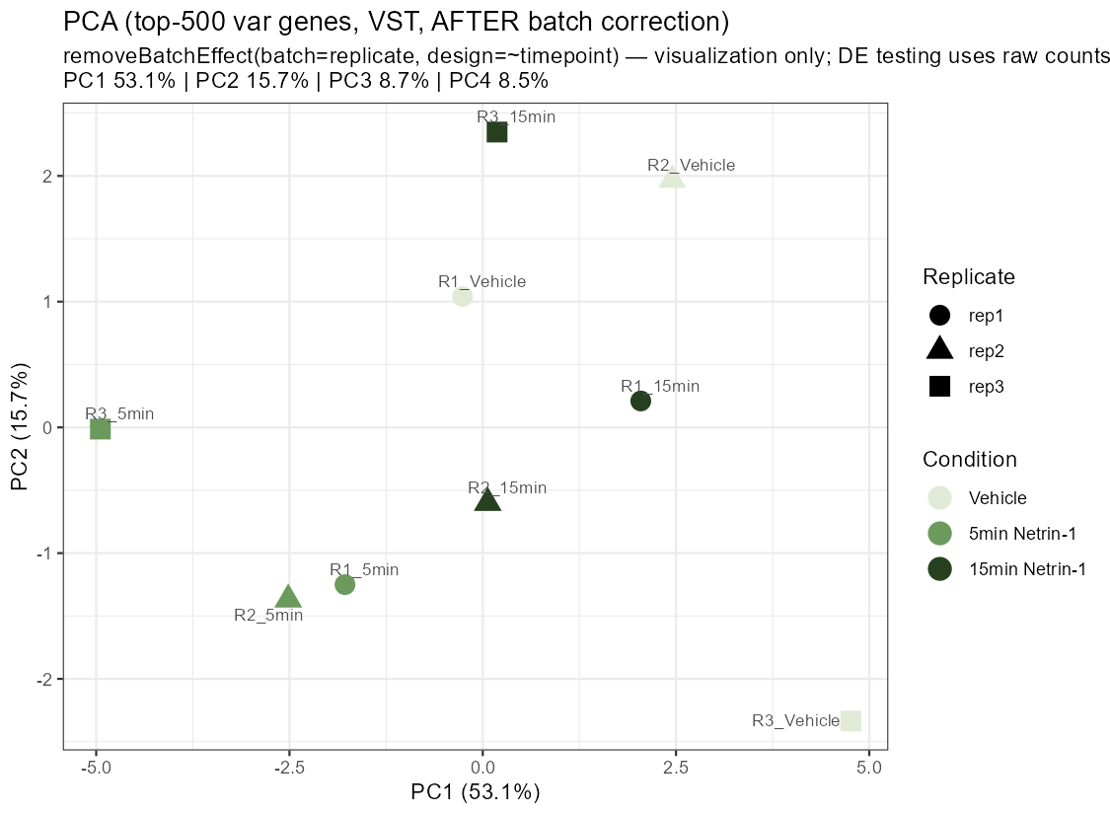
RESULTS · QC
Quality control II — replicate is the top batch effect
▸ Top axis of variation = biological REPLICATE, not treatment.
– Replicate ≈ 52% of variance; timepoint ≈ 34%.
▸ Handled correctly:
– Replicate is a batch term in the DE model.
– limma removeBatchEffect for visualization only.
▸ After correction, PC1 mainly reflects TIMEPOINT.
– Samples separate by 0 / 5 / 15 min as expected.
10
Notes:
TIMING ~1.5 min. Second QC point, and it's about honesty with the data. The single largest source of variation is not the treatment — it's the biological replicate, about 52% versus 34% for timepoint. If you ignore that, the treatment effect drowns. So replicate goes into the model as a batch term. This PCA is shown AFTER correcting for replicate, for visualization, and now PC1 lines up with the timepoint axis — 0, 5, and 15 minutes separate. Again: I correct only for the picture; the statistics run on raw counts with the batch term.

Slide 11
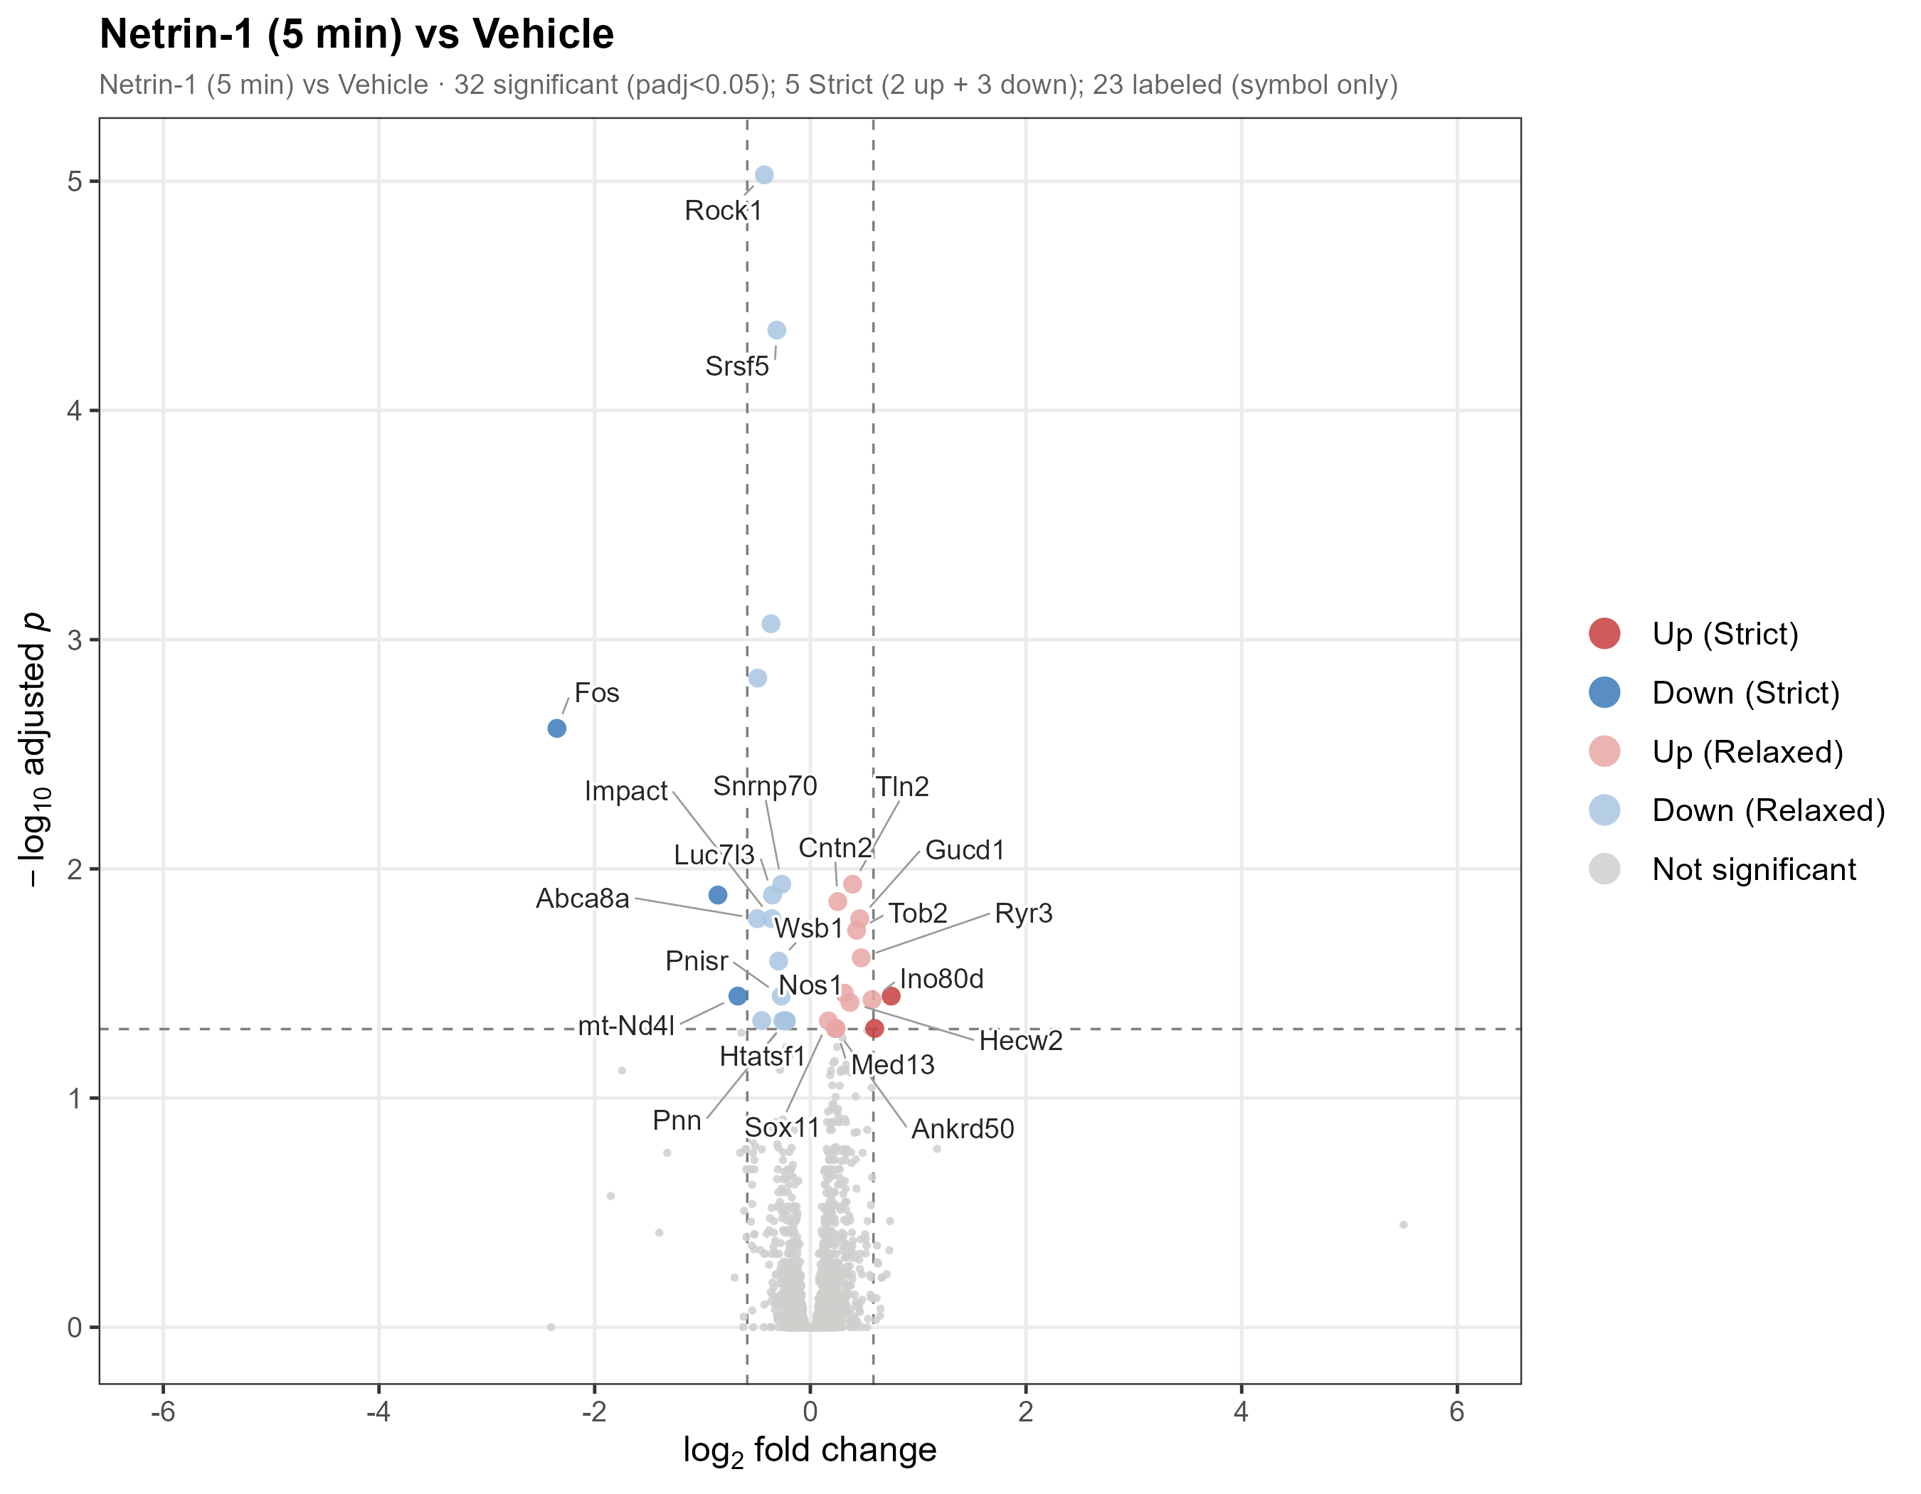
RESULTS · DEGS
Result 1 — the 5-minute response is real but small
▸ 5-vs-0 differential expression:
– RELAXED (padj<0.05): 32 DEGs (14 ↑ / 18 ↓).
– STRICT (+FC>1.5): 5 DEGs (2 ↑ / 3 ↓).
▸ Fos is the standout:
– log2FC −2.35, padj 2.4e-3 — strongly DOWN.
▸ Most effect sizes are modest…
– …consistent with a fast, subtle, pathway-level signal rather than a few large switches.
▸ → motivates the GSEA analysis (coming up).
11
Notes:
TIMING ~1.5 min. Now results. This is the 5-versus-0 volcano. At a relaxed FDR cut there are 32 differentially expressed genes — 14 up, 18 down; at a strict cut that also demands a 1.5-fold change, just five survive. The clear outlier, far to the left, is Fos: down more than fourfold. I'll come back to Fos because its DIRECTION is surprising. The headline here is that the response is real but small at the single-gene level — most points are modest. That's exactly why, two slides from now, I move to pathway-level GSEA, where many small coordinated changes add up to a clear signal.

Slide 12
RESULTS · DEGS
Core 5-minute DEGs map onto coherent modules
Gene
log2FC
padj
Module
Fos
−2.35
2.4e-3
Immediate-early gene (IEG ↓)
Rock1
−0.43
9.4e-6
Cytoskeleton / ROCK
Srsf5
−0.31
4.5e-5
Splicing
Snrnp70
−0.27
1.2e-2
Splicing
Cntn2
+0.25
1.4e-2
Axon guidance
Nos1
+0.32
3.5e-2
NO–calcium
Ryr3
+0.47
2.4e-2
NO–calcium
Tln2
+0.39
1.2e-2
Adhesion
Down: IEG, cytoskeleton, splicing. Up: axon guidance, NO–calcium, adhesion. Individually small — but they fall into clean, interpretable modules.
12
Notes:
TIMING ~1.5 min. Zooming into those genes — and this is the key transition from 'genes' to 'biology'. Look at the modules in the right column. The DOWN genes are not random: Fos, an immediate-early gene; Rock1, cytoskeleton; Srsf5 and Snrnp70, both splicing factors. The UP genes are equally coherent: Cntn2, axon guidance; Nos1 and Ryr3, nitric-oxide/calcium; Tln2, adhesion. Individually these effects are small, but they sort into clean, interpretable modules — exactly what you'd expect from a coordinated program, and a preview of what GSEA will confirm at genome scale.

Slide 13
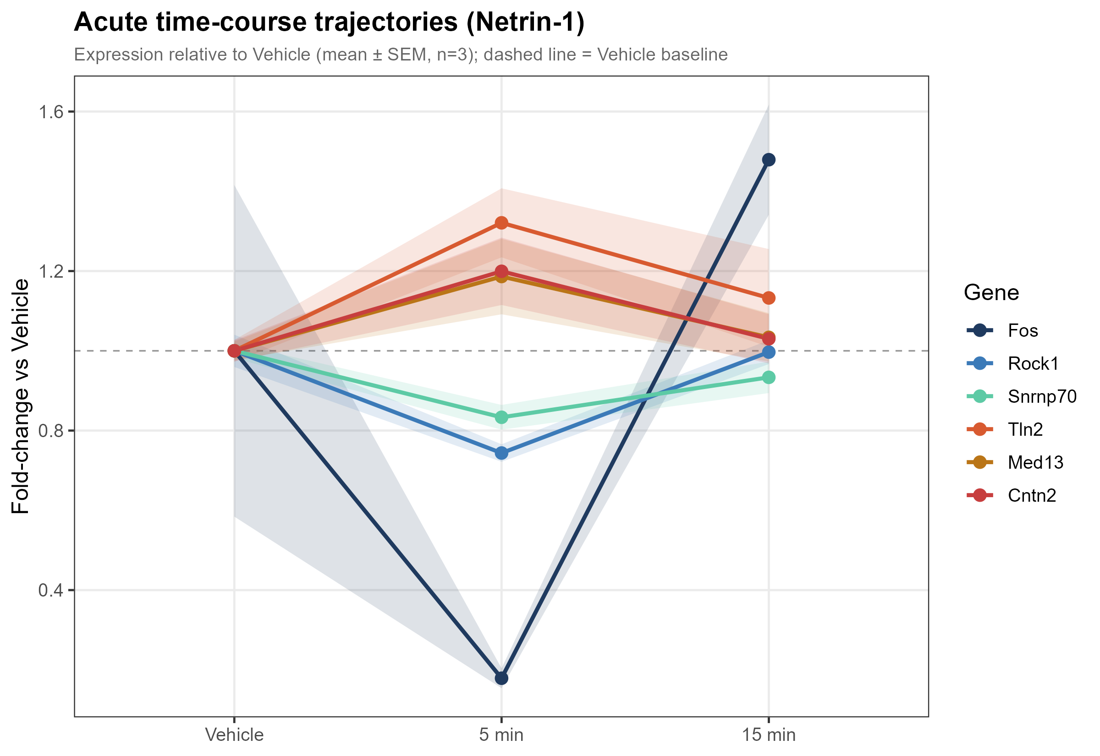
RESULTS · DYNAMICS
Result 2 — the response is a transient 5-minute pulse
▸ LRT finds 19 genes that change significantly over time.
▸ The dominant shape: a 5-minute PULSE —
– depart from baseline at 5 min…
– …then return toward baseline by 15 min.
▸ This is the first direct evidence the program is TRANSIENT, not sustained.
▸ Caveat (shown honestly):
– Fos at 15 min overshoots baseline; its Vehicle replicates are variable → wide error band.
13
Notes:
TIMING ~1.5 min. Result two answers the transient-versus-sustained question. A likelihood-ratio test flags 19 genes that change significantly across the three timepoints, and the dominant trajectory shape is a PULSE: they move away from baseline at 5 minutes and come back by 15. This is the first direct evidence that the program is transient. I'll show you the genome-wide version of this in a moment. One honest caveat: Fos doesn't just return — at 15 minutes it overshoots baseline, and its vehicle replicates are noisy, so its error band is wide. I flag that rather than hide it.

Slide 14
RESULTS · DYNAMICS
A surprise: two immediate-early genes are SUPPRESSED
Immediate-early genes are normally ACTIVATED by neuronal activity. Here, acute Netrin-1 does the opposite — it acutely DOWN-regulates them.
Fos
log2FC −2.35 · padj 2.4e-3
The strongest DEG of the whole study.
Strong, significant acute repression.
Npas4
log2FC −1.75 · padj 0.076 (Wald, n.s.)
Significant by the time-course LRT.
A second acutely-repressed IEG.
14
Notes:
TIMING ~1.5 min. This slide is one of the most interesting findings. Immediate-early genes like Fos and Npas4 are the textbook markers of neuronal ACTIVATION — they go UP within minutes of activity. Here, acute Netrin does the opposite: it acutely SUPPRESSES them. Fos is down more than fourfold and is the single strongest DEG in the study. Npas4 is down about 3.4-fold; it misses the per-contrast significance cut but is picked up by the time-course LRT. So we have two independent immediate-early genes being acutely repressed. That's a genuinely novel and slightly counterintuitive observation — I'll return to what it might mean in the discussion.

Slide 15
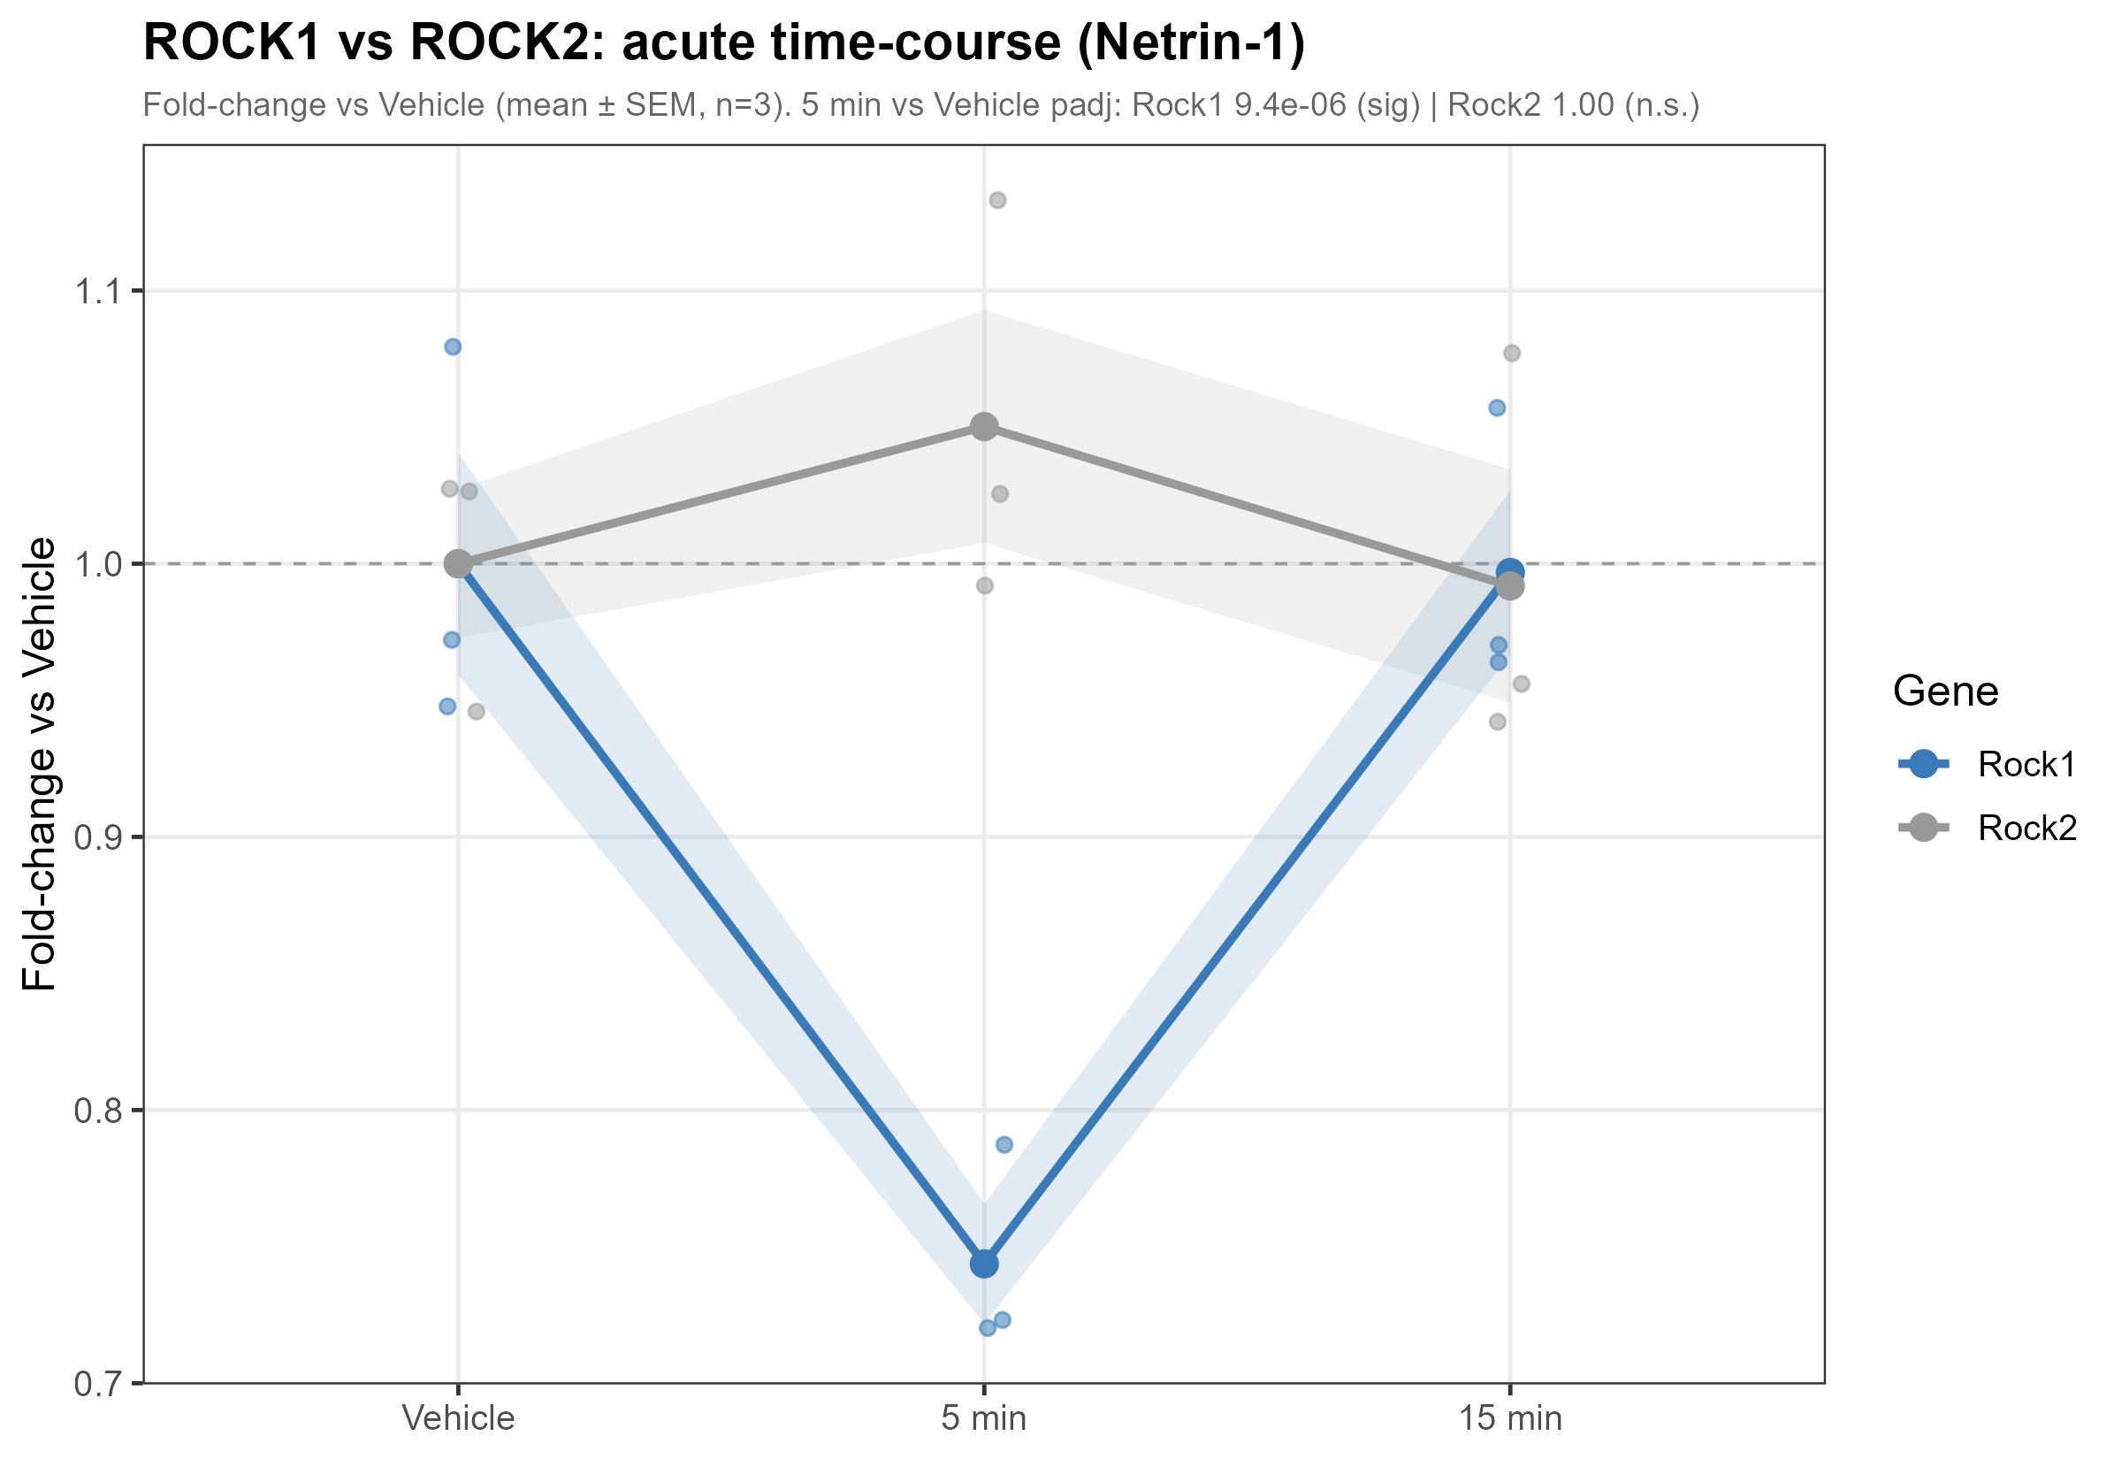
RESULTS · DYNAMICS
Selective control: Rock1 down, Rock2 untouched
▸ Rock1: log2FC −0.43, padj 9.4e-6 — clearly DOWN.
▸ Rock2: log2FC +0.07, padj ≈ 1.0 — unchanged.
▸ Two paralogues, opposite fates within one cell.
▸ ROCK1 is a classic downstream effector of Netrin–DCC signaling.
▸ Implication: Netrin exerts ISOFORM-SELECTIVE transcriptional control — precise, not a blunt instrument.
15
Notes:
TIMING ~1.5 min. Here's a nice illustration of precision. ROCK kinases come in two paralogues, Rock1 and Rock2. Netrin selectively knocks down Rock1 — highly significant, padj around 1e-5 — while Rock2 doesn't move at all. Same cell, same family, opposite outcomes. And it's not arbitrary: ROCK1 is a canonical downstream effector of Netrin–DCC signaling, so its selective transcriptional suppression dovetails with the known protein-level biology. The takeaway is that this acute program is SELECTIVE — Netrin is reaching in and tuning specific isoforms, not broadly shaking the transcriptome.

Slide 16
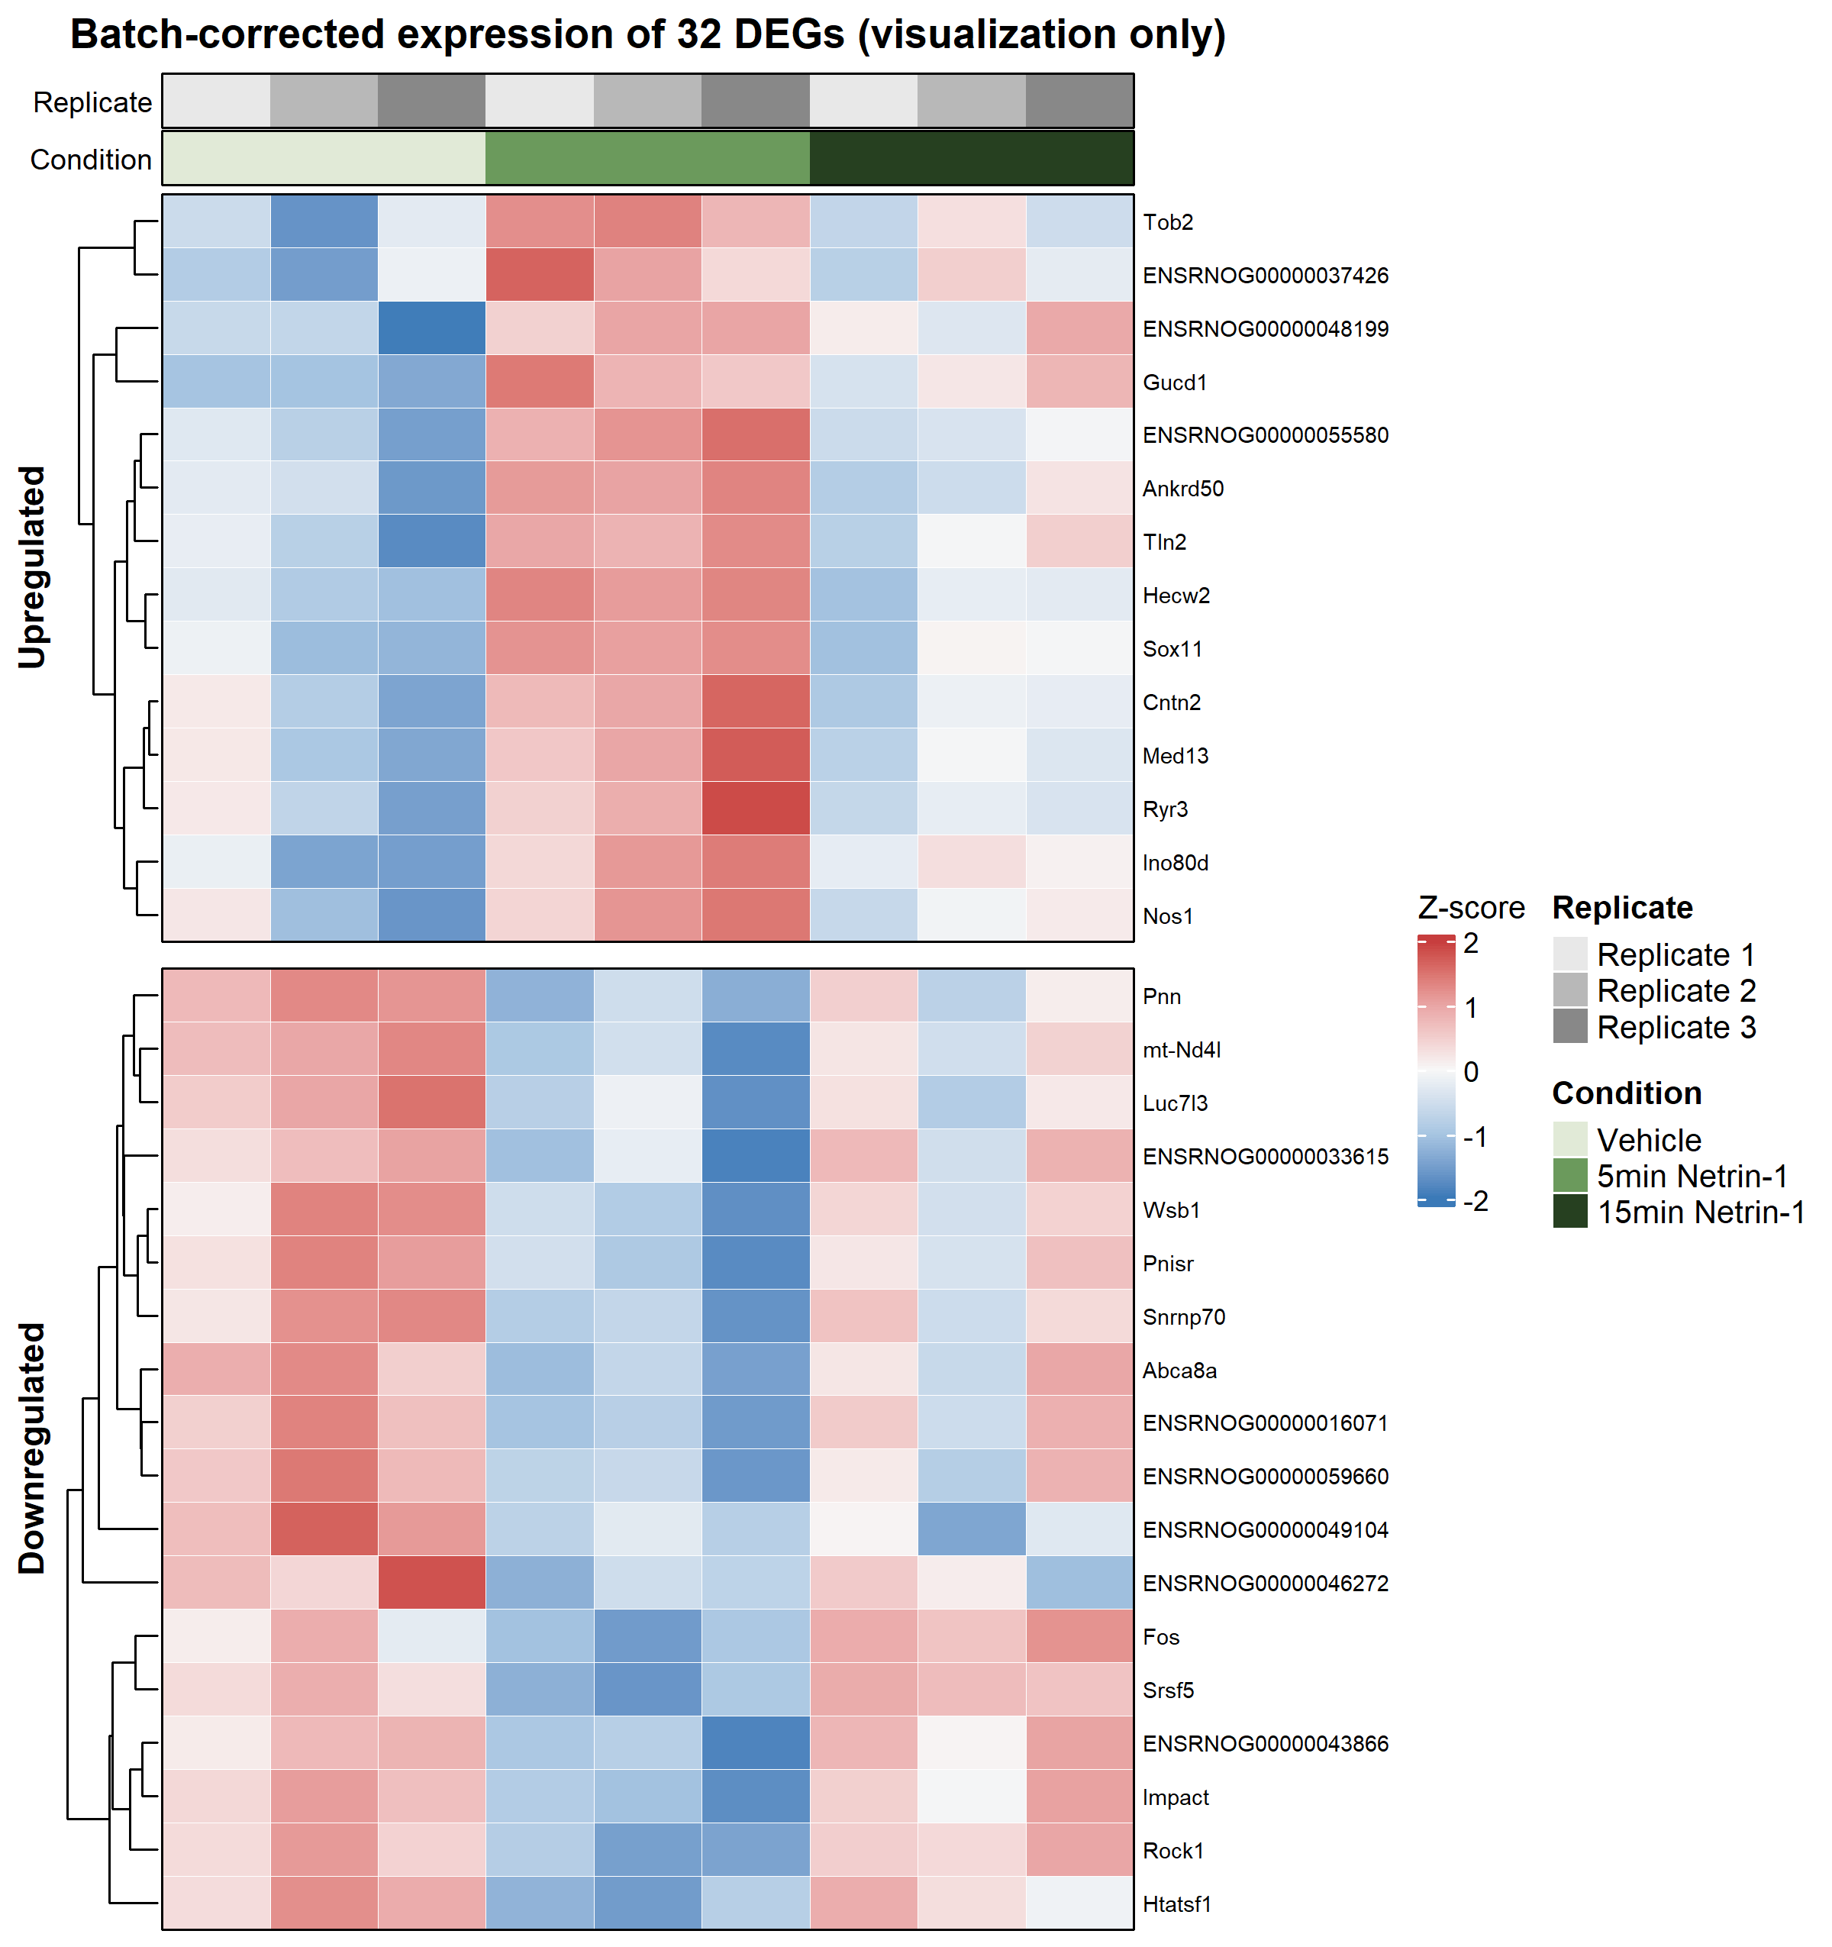
RESULTS · DYNAMICS
DEGs separate the conditions coherently
▸ Heatmap of 5-vs-0 DEGs across all samples.
▸ Coordinated up- and down-blocks distinguish the Netrin-5min condition.
▸ Patterns are consistent within replicates after batch handling.
▸ Confirms, at the expression-matrix level, that the 5-minute state is a distinct and coherent program —
– not scattered noise across a few genes.
16
Notes:
TIMING ~1 min. A quick consolidating view: the DEGs from the 5-versus-0 contrast, drawn as a heatmap across all nine samples. You can see coherent blocks — a set going up and a set going down — that together mark out the 5-minute Netrin state. The point of this slide is simply that the 5-minute response holds together as a structured pattern across the whole expression matrix, not as a handful of isolated genes. With the gene-level story established, let's go to the pathway level.

Slide 17
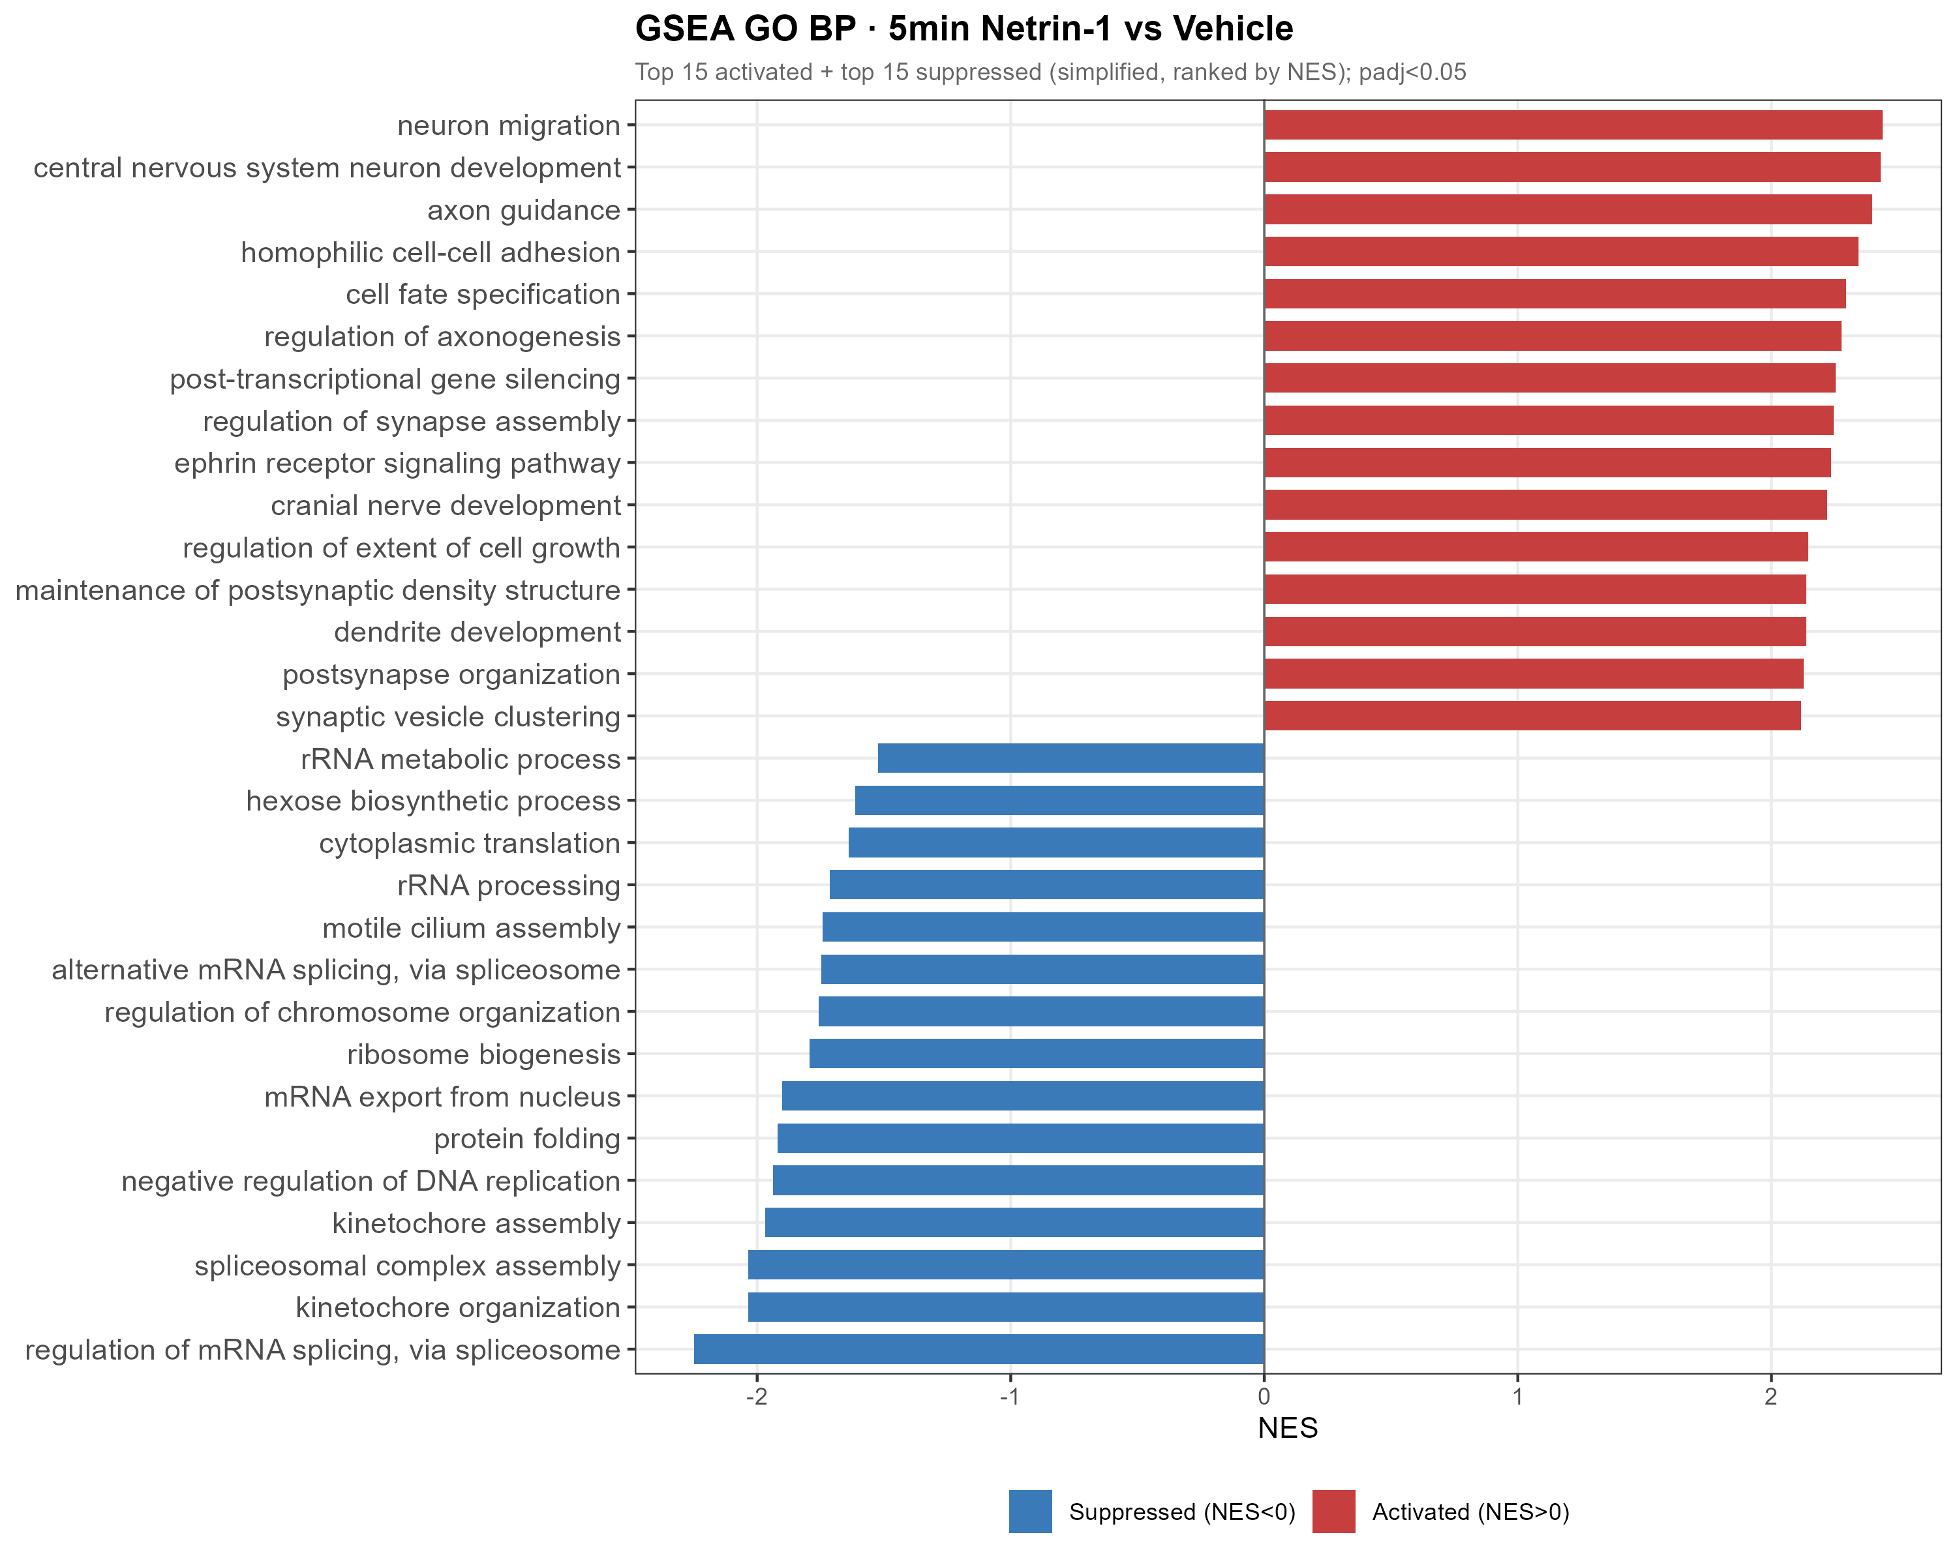
RESULTS · PATHWAYS
Result 3 — GSEA reveals a coordinated program
▸ 5v0 GO-BP: 313 significant terms (285 ↑ / 28 ↓).
▸ ACTIVATED at 5 min:
– axon guidance, neuron projection, synapse assembly.
▸ SUPPRESSED at 5 min:
– mRNA splicing / processing,
– ribosome biogenesis & translation.
▸ GSEA elevates the single-gene modules into a genome-wide, coordinated signal.
17
Notes:
TIMING ~1.5 min. This is where it all comes together. At the pathway level the 5-minute response is unmistakable — 313 significant GO biological-process terms. Two coherent arms. ACTIVATED: axon guidance, neuron projection, synapse assembly — Netrin's own functional territory, now visible at the transcriptional level within minutes. SUPPRESSED: RNA splicing and processing, and ribosome biogenesis and translation — the cell's general biosynthetic machinery. The same modules I showed gene-by-gene now appear as a genome-wide, coordinated push-pull. This is the core result of the thesis.

Slide 18
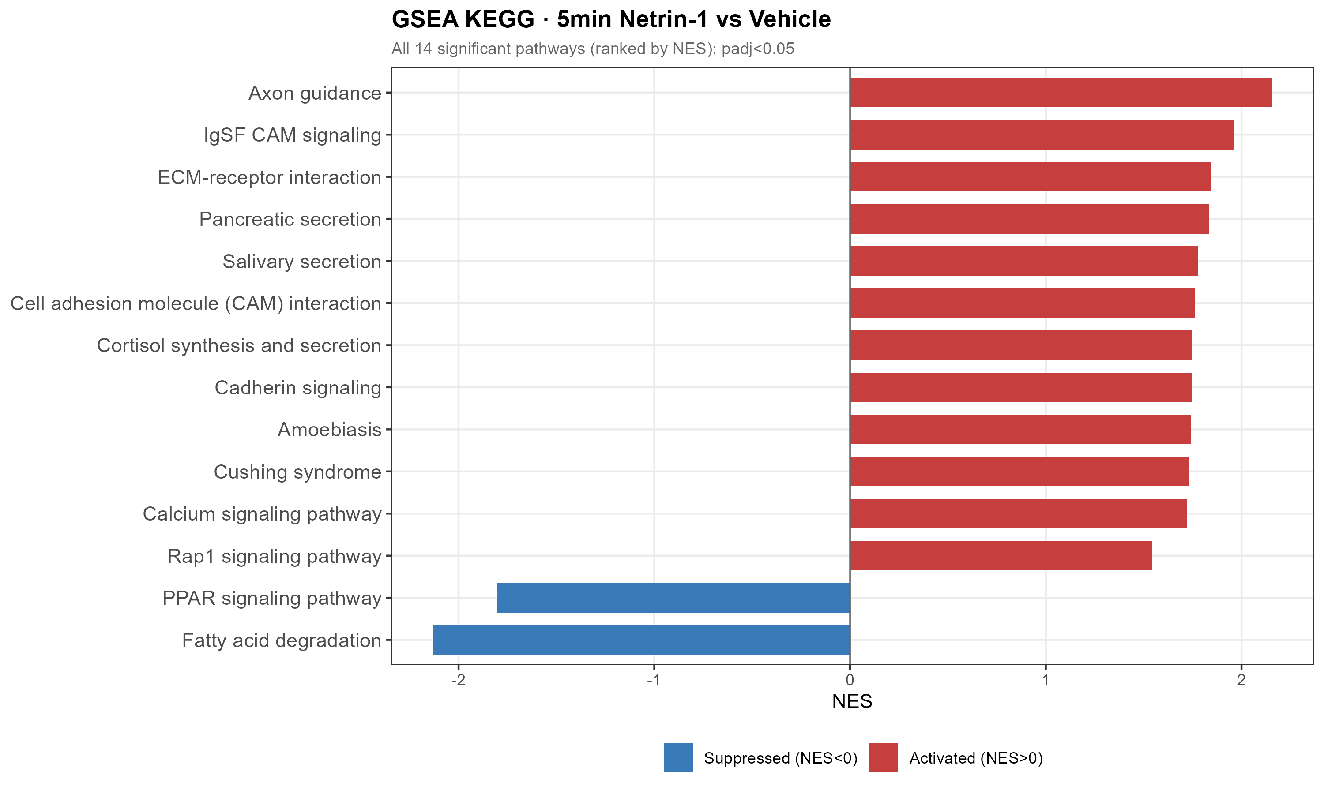
RESULTS · PATHWAYS
KEGG: axon guidance tops the activated pathways
▸ 5v0 KEGG: 14 significant pathways.
▸ Axon guidance ranks first.
– Includes the parallel ephrin guidance system.
▸ Netrin's canonical, protein-level function is mirrored at the transcriptional level — in 5 minutes.
▸ Suggests transcription RUNS IN PARALLEL with the classic post-translational mechanism, not just after it.
18
Notes:
TIMING ~1.5 min. The KEGG view sharpens the headline. Of 14 significant pathways, axon guidance ranks first — and it brings along the parallel ephrin guidance system. Think about what that means: Netrin's classic job is to steer growth cones through fast protein-level signaling. Here we see the SAME guidance program switched on transcriptionally within five minutes. So transcription isn't a slow afterthought that happens hours later — it runs in parallel with the canonical mechanism, reinforcing the very program Netrin is known for.

Slide 19
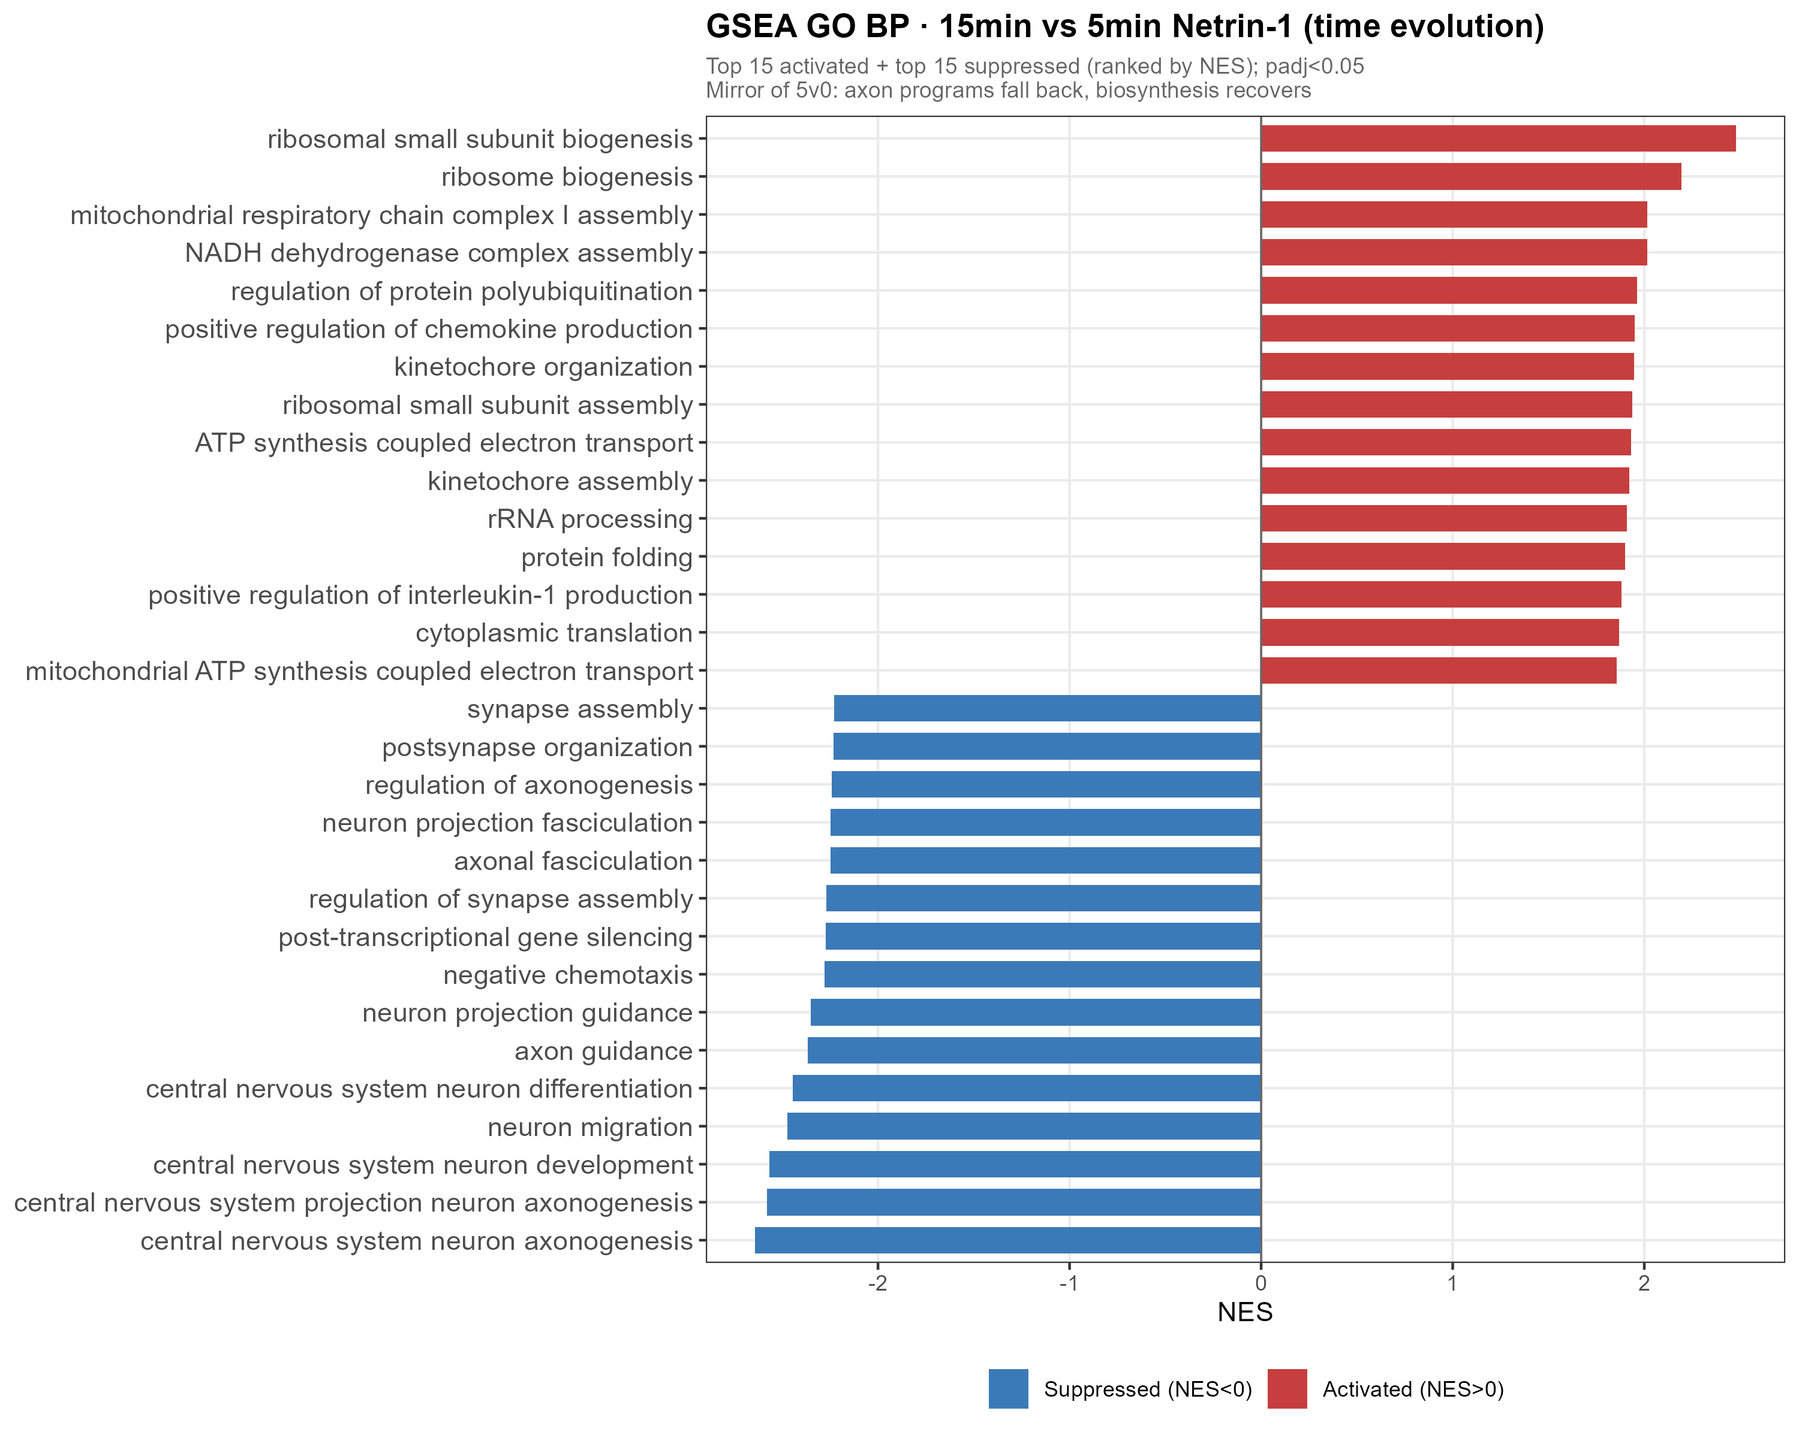
RESULTS · RETURN
Result 4 — by 15 min the program fully reverses
▸ 15v5 GO-BP: 295 significant terms (31 ↑ / 264 ↓).
▸ Direction is FLIPPED versus 5v0:
– axon-guidance terms now go DOWN,
– biosynthesis terms now go UP (recover).
▸ 15v0 GO-BP: 0 significant terms.
– → at 15 min the transcriptome is back at baseline.
▸ The program is switched on at 5 min, off by 15.
19
Notes:
TIMING ~1.5 min. Result four closes the loop. Look at the 15-versus-5 contrast: 295 significant terms, but now the SIGN is reversed. The axon-guidance terms that went up at 5 minutes are going down; the biosynthesis terms that were suppressed are recovering. And the clincher: the 15-versus-0 contrast has ZERO significant GO terms. In other words, by 15 minutes the transcriptome is statistically indistinguishable from baseline. The program is switched on at 5 minutes and switched off by 15. Now let me quantify just how precise that reversal is.

Slide 20
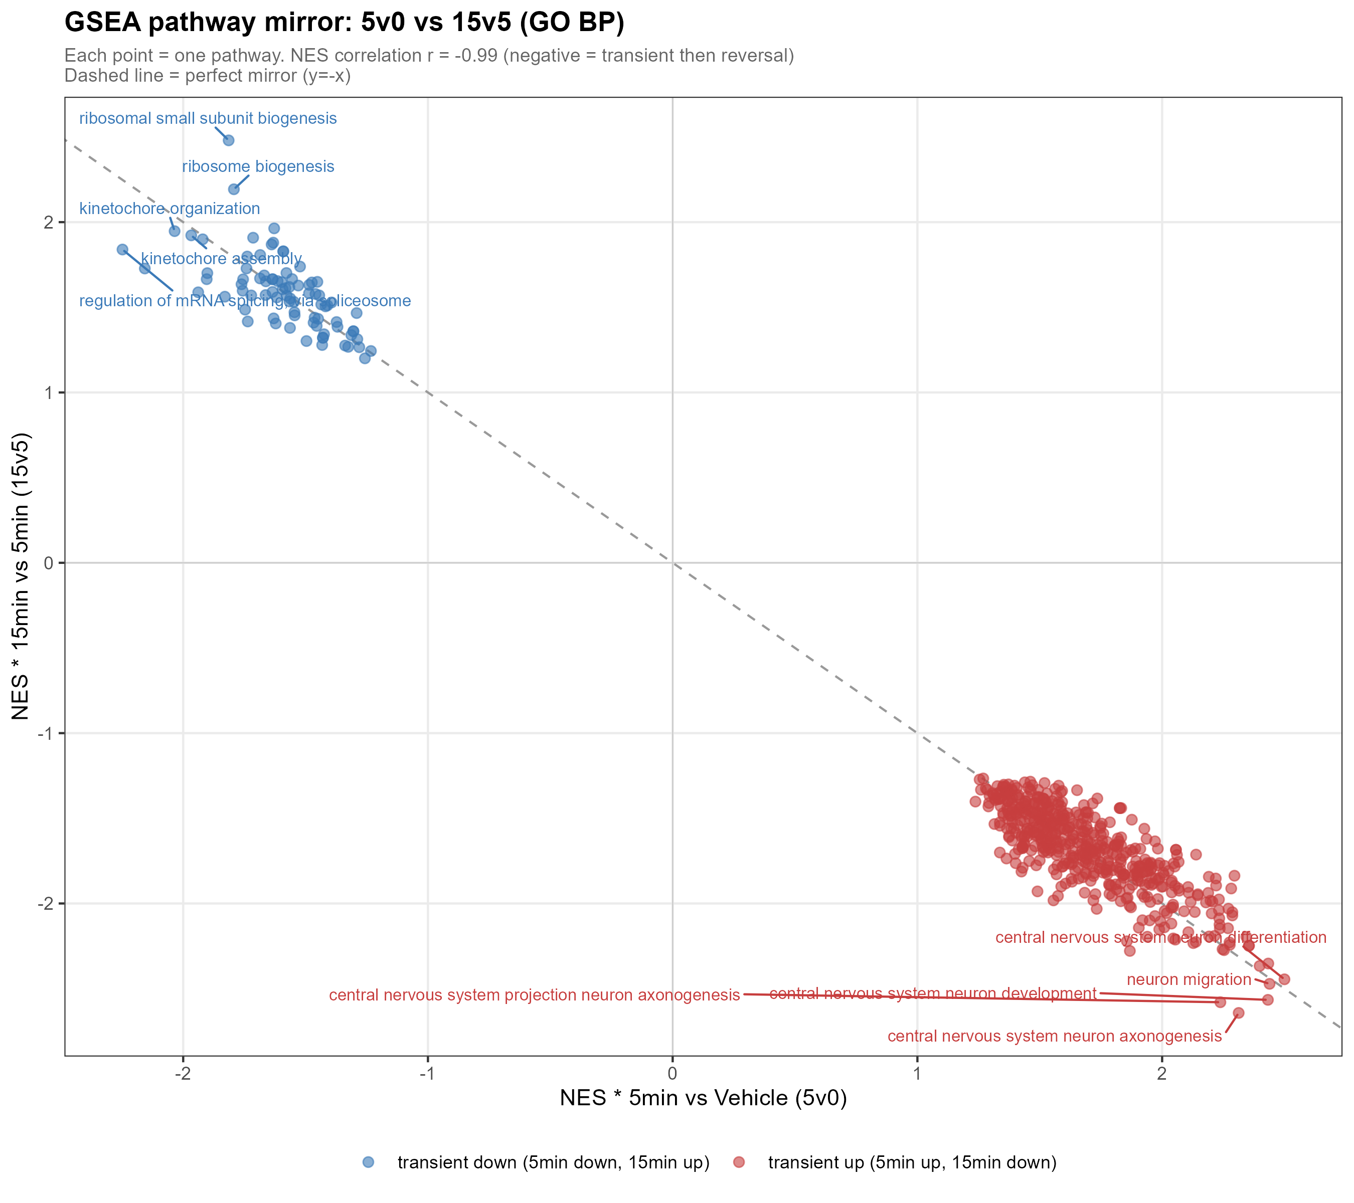
RESULTS · RETURN
The signature result: an r = −0.99 mirror
r = −0.99
5v0 vs 15v5 pathway NES correlation
▸ 603 pathways shared between 5v0 and 15v5.
▸ Their enrichment scores are near-perfect opposites.
▸ Every pathway activated at 5 min is suppressed from 5→15 min by almost exactly the same amount.
▸ Quantitative proof that the 5-minute program is PRECISELY UNDONE — a true transient.
20
Notes:
TIMING ~2 min. This is the slide I'd ask you to remember. I took the 603 pathways shared between the 5-versus-0 and 15-versus-5 contrasts and plotted their enrichment scores against each other. The correlation is minus 0.99 — a near-perfect anti-correlation. Concretely: every pathway that goes up in the first five minutes comes back down over the next ten by almost exactly the same magnitude. This is the quantitative backbone of the whole thesis. It tells us the 5-minute response isn't just fading randomly — it is being PRECISELY REVERSED. That is the definition of a transient, tightly-controlled program, and it's the study's strongest single piece of evidence.

Slide 21
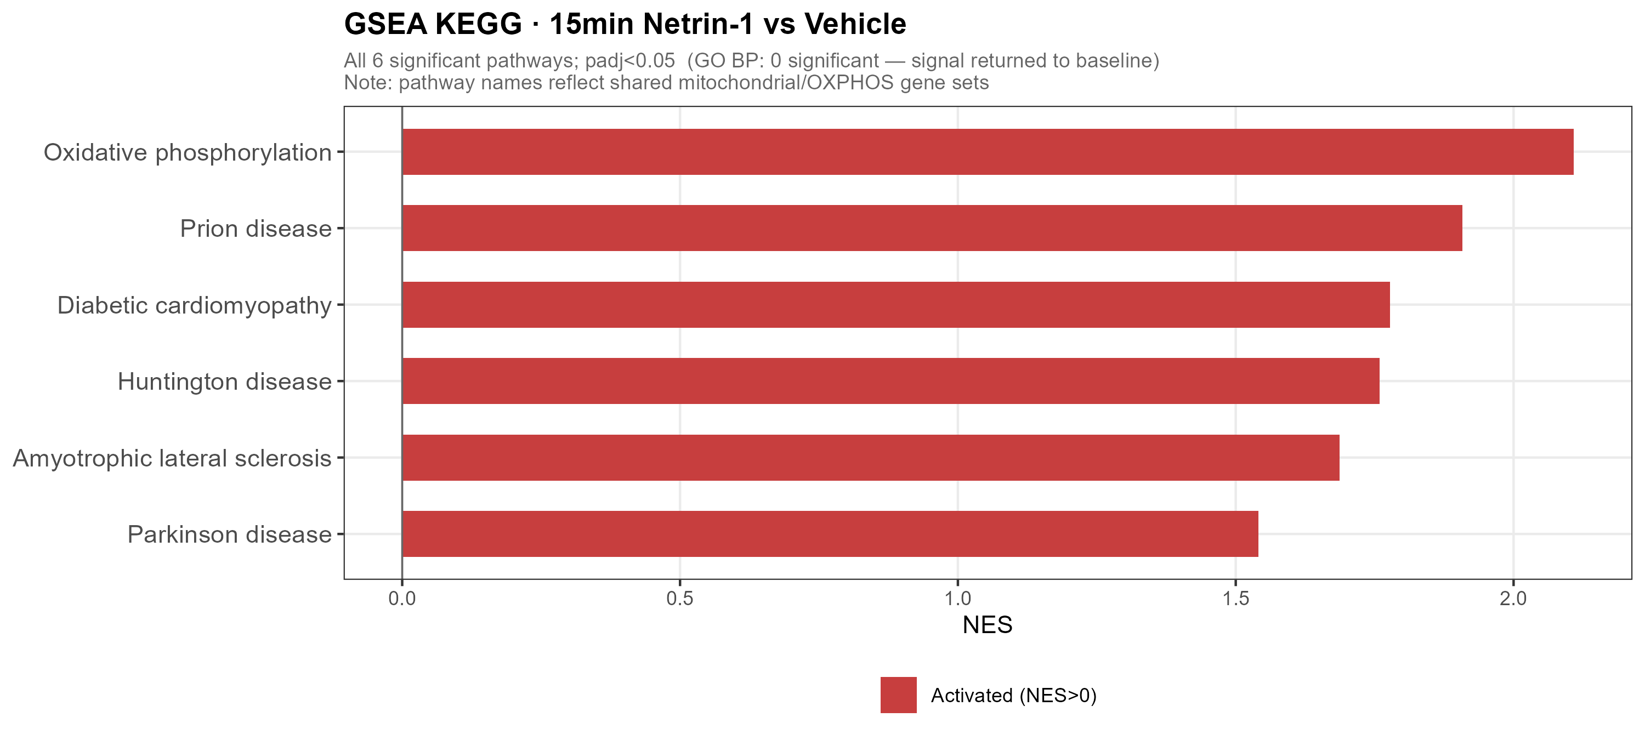
RESULTS · RETURN
A late, secondary signal: mitochondrial OXPHOS
▸ At 15 min, a mild UP-regulation of mitochondrial OXPHOS / NADH-dehydrogenase genes emerges.
▸ Appears later than the main 5-minute program.
▸ Interpretation caveat (important):
– KEGG labels these as 'Prion / Huntington / Parkinson' disease pathways…
– …but those share the same mitochondrial genes.
– Read as OXPHOS up-regulation — NOT disease pathways.
21
Notes:
TIMING ~1 min. One secondary observation, with a necessary caveat. At 15 minutes a mild up-regulation of mitochondrial oxidative-phosphorylation genes appears — a later, smaller signal layered on top of the main reversal, perhaps an energetic response. The caveat: KEGG annotates these genes under disease names — Prion, Huntington, Parkinson — but that is an annotation artifact. Those 'disease' pathways are built from the same mitochondrial OXPHOS genes. The correct biological reading is OXPHOS up-regulation, full stop, not anything about neurodegenerative disease. I make a point of stating that so the result isn't over-interpreted.

Slide 22
SYNTHESIS
Putting it together: modules of the transient program
Module
5 min
→ 15 min
Evidence
Splicing / RNA processing
down
recover
DEG + GSEA + LRT
Ribosome / translation
down
recover
GSEA + mirror
Immediate-early genes
down
rebound
Fos, Npas4 (LRT)
Cytoskeleton / ROCK
down
recover
Rock1 (Rock2 n.s.)
Axon guidance / projection
up
fall back
DEG + GSEA + KEGG
Synapse assembly
up
fall back
GSEA
NO–calcium signaling
up
fall back
Nos1, Ryr3 + KEGG
Adhesion
up
fall back
Tln2 + KEGG
Mitochondria / OXPHOS
flat
late rise
GSEA 15v5 / 15v0
One coherent program: guidance/projection UP, biosynthesis & IEGs DOWN at 5 min — all reversing by 15 min, with a late OXPHOS rise.
22
Notes:
TIMING ~1.5 min. Here's the whole study on one table. Read the middle two columns as the story: at 5 minutes, guidance, projection, synapse assembly, NO-calcium and adhesion go UP; splicing, ribosome biogenesis, IEGs and ROCK go DOWN. The third column shows every one of those returning toward baseline by 15 minutes — recover, rebound, fall back. The only thing that's a LATE riser rather than a reverser is mitochondrial OXPHOS. And the right column shows each module is supported by multiple independent lines of evidence — DEGs, GSEA, the LRT, and the mirror. That convergence is what gives me confidence in the model.

Slide 23
SYNTHESIS
A model: switch on at 5 min, switch off by 15
UP: axon guidance · projection · synapse · NO–calcium · adhesion
DOWN: splicing · ribosome biogenesis · translation · IEGs · ROCK1
0 min
Vehicle
activate
→
5 min
Netrin-1
reverse
→
15 min
Netrin-1
A 5-minute Netrin-1 pulse drives a coordinated transcriptional swing, then near-perfectly reverses it (r = −0.99) by 15 minutes — a transient program, with a late OXPHOS rise as the one lingering signal.
23
Notes:
TIMING ~1.5 min. Here is the model in one picture. Baseline at zero. At five minutes a coordinated swing — guidance, projection, synapse, NO-calcium and adhesion up; splicing, ribosome biogenesis, translation, IEGs and ROCK1 down. Then, over the next ten minutes, that entire swing is reversed with r = minus 0.99 precision, back to baseline. A transient program — switched on, then switched off — with mitochondrial OXPHOS as the one signal that lingers and even rises late. This is the graphical abstract of the thesis.

Slide 24
DISCUSSION
Discussion — five take-home messages
1
Dual IEG suppression — Fos AND Npas4 are acutely DOWN-regulated — opposite to the canonical activity-induced behavior of IEGs. A novel observation.
2
Coordinated biosynthesis shutdown — Splicing + ribosome biogenesis + translation are transiently suppressed together — possibly reallocating resources toward local translation.
3
Guidance program — transcriptional arm — Axon guidance is induced at the mRNA level in minutes, running in parallel with Netrin's classic post-translational mechanism.
4
r = −0.99 transient reversal — A near-perfect mirror: the 5-min program is precisely undone by 15 min. The study's strongest quantitative result.
5
ROCK1-selective control — Rock1 down, Rock2 unchanged — isoform-specific regulation of a canonical Netrin–DCC effector.
24
Notes:
TIMING ~2.5 min. Five take-homes. One — dual IEG suppression: both Fos and Npas4 go down, the opposite of how IEGs usually behave; that's novel and mechanistically intriguing. Two — a coordinated transient shutdown of biosynthesis: splicing, ribosome biogenesis and translation all dip together, which may reflect resource reallocation toward local translation at the growth cone. Three — the guidance program has a fast transcriptional arm that parallels the classic protein-level mechanism. Four — the minus-0.99 mirror, the quantitative heart of the work. Five — ROCK1-selective control, showing the precision of the response. Each of these is a thread worth pulling in future work.

Slide 25
DISCUSSION
Limitations — read honestly
▸ n = 3, and the acute signal is weak.
– Most single-gene effects are small → pathway-level GSEA is the primary analysis.
▸ No independent PBS-15min control.
– The 15-vs-0 contrast confounds treatment with elapsed time; main results rely on 5v0 and 15v5.
▸ Only three timepoints.
– Dynamics inferred via LRT + trend classification; dense time-series methods (e.g. ImpulseDE2) are not applicable.
▸ Fos shows high Vehicle-replicate variability.
– Its trajectory error band is wide — interpreted cautiously.
▸ Bulk RNA-seq, not single-cell.
– Markers reflect overall expression, not cell-type proportions.
25
Notes:
TIMING ~1.5 min. I want to be candid about limitations — they shaped my analytical choices. With n=3 and a weak acute signal, most single-gene effects are small, which is exactly why GSEA is my primary analysis rather than gene-by-gene claims. There's no independent 15-minute vehicle, so I avoid leaning on the 15-vs-0 contrast. With only three timepoints I use an LRT and trend classification rather than dense time-series modeling. Fos's vehicle replicates are variable, so I read its trajectory cautiously. And this is bulk data, so my marker statements are about expression, not cell-type proportions. None of these undercut the central transient-reversal result, but they bound its interpretation.

Slide 26
WRAP-UP
Conclusions
Acute Netrin-1 triggers a rapid, coordinated and TRANSIENT transcriptional program in cortical neurons — activating axon-guidance / projection while suppressing RNA processing and ribosome biogenesis — that is reversed to baseline with r = −0.99 precision within 15 minutes.
▸ First characterization of Netrin-1's minute-scale transcriptional response.
▸ Transcription runs in PARALLEL with the classic post-translational mechanism.
▸ Novel findings: dual-IEG suppression and ROCK1-selective regulation.
▸ The r = −0.99 mirror defines a precisely-controlled transient — not reprogramming.
26
Notes:
TIMING ~1.5 min. To conclude. This is, to my knowledge, the first characterization of Netrin-1's transcriptional response on a minute timescale. The headline: a rapid, coordinated, transient program — guidance up, biosynthesis down — reversed to baseline with r = minus 0.99 precision within 15 minutes. Three contributions worth restating: transcription runs in parallel with the classic protein-level mechanism, not after it; we find two genuinely novel features — dual-IEG suppression and ROCK1-selective control; and the mirror result reframes the acute response as a precisely-controlled transient rather than a lasting reprogramming.

Slide 27
WRAP-UP
Future directions
▸ Denser time course (+ proper per-timepoint controls) to map the full pulse shape.
▸ Single-cell / spatial RNA-seq to localize the response to neuronal subtypes & compartments.
▸ Mechanism of dual-IEG suppression — what represses Fos and Npas4 acutely?
▸ Link the transient transcriptional swing to local translation at the growth cone.
▸ Test DCC/UNC5 dependence and ROCK1-selectivity with perturbations.
27
Notes:
TIMING ~1 min. Where next. First, a denser time course with proper per-timepoint controls to resolve the full shape of the pulse. Second, single-cell or spatial RNA-seq to see which neurons and which compartments drive the signal. Third, the mechanism behind dual-IEG suppression — what's actively repressing Fos and Npas4 in minutes? Fourth, connecting this transcriptional swing to local translation at the growth cone. And fifth, perturbation experiments to test DCC/UNC5 dependence and the ROCK1 selectivity directly. Any of these would build naturally on the foundation here.

Slide 28
Thank you
Questions & discussion welcome
One sentence to remember:
A 5-minute Netrin-1 pulse switches a coordinated transcriptional program ON — then OFF again by 15 minutes, with r = −0.99 precision.
Notes:
TIMING ~0.5 min + Q&A. Thank you — I'm happy to take questions. If you forget everything else: a five-minute Netrin pulse switches a coordinated transcriptional program on, then off again by fifteen minutes, with r = minus 0.99 precision. Likely questions to be ready for: why are IEGs going DOWN; how robust is the mirror given n=3; the shared-control limitation; and whether bulk masks subtype-specific effects.

